Slide 1
Lesson 11: Implementing a Compelling UI in React
11.1 Introducing the Example Application
11.2 Implementing Routing
11.3 Displaying All Destinations
11.4 Displaying One Destination
11.5 Displaying and Adding Reviews for a Destination

Slide 2
Lesson 11: Implementing a Compelling UI in React
11.1 Introducing the Example Application

Slide 3
Overview
We're going to see how to implement a complete React UI that interacts with a back-end Spring Boot server application:
React
client app
Spring Boot server app
Database
REST
SQL

Slide 4
Running the Applications
Run the Spring Boot server application first:
In IntelliJ, open demo-full-stack-app
Run the Application class
Starts the server web app on port 8080
Now run the React client application:
Open a Command Prompt window
Go to demo-full-stack-client
Run
Run
Starts the client web app on port 3000
npm install
npm start

Slide 5
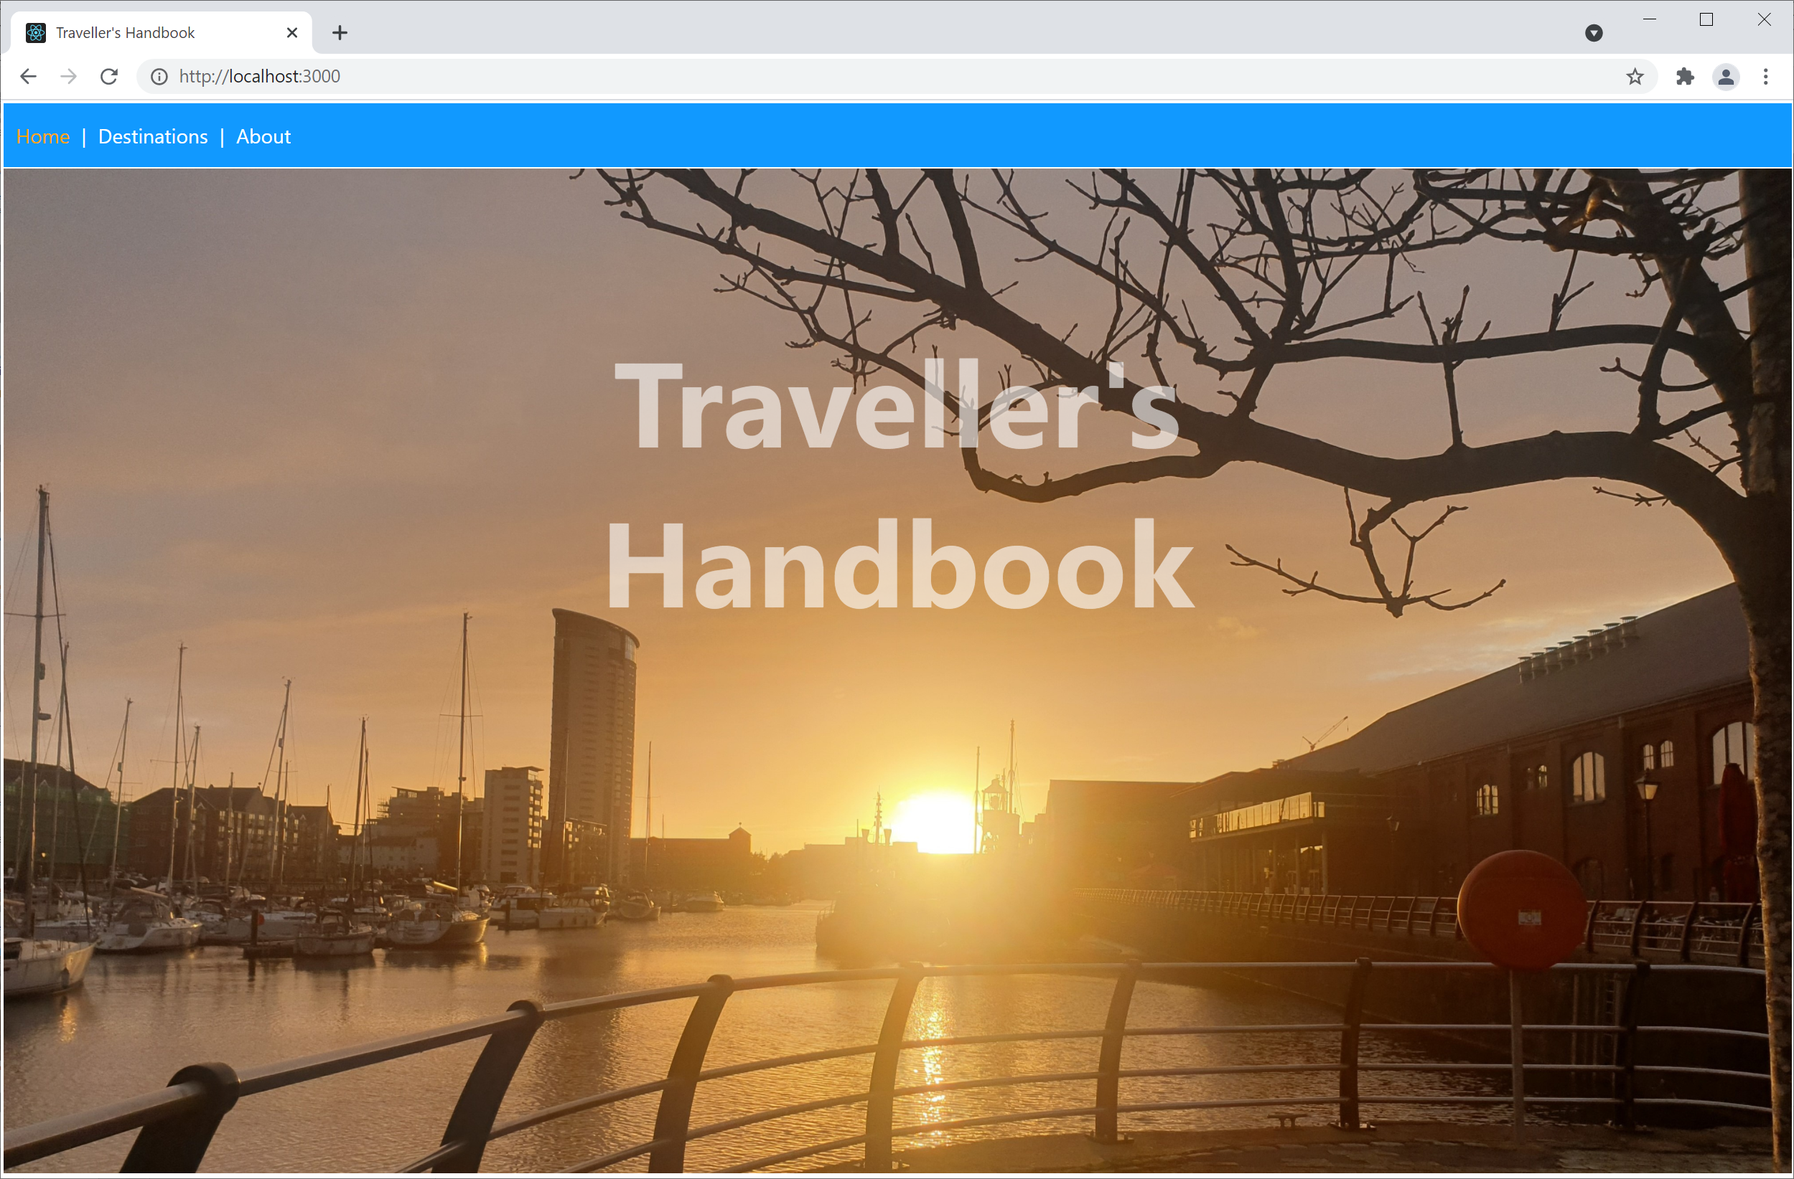
Using the React Client Application
Open a browser and ping http://localhost:3000/

Slide 6
Application Characteristics
The application has several key characteristics:
Single-page application (SPA)
Compelling UI
Realistic application structure
Uses contemporary React techniques
Interacts with Spring Boot REST service

Slide 7
Lesson 11: Implementing a Compelling UI in React
11.2 Implementing Routing

Slide 8
Overview
We're going to see how to use React "routing" to create a single-page application (SPA)
Here's a reminder of how to run the server application:
In IntelliJ, open demo-full-stack-app
Run the Application class
Here's a reminder of how to run the React client application:
Open a Command Prompt window in demo-full-stack-client
Run
Run
npm install
npm start

Slide 9
React and SPAs
React has excellent support for implementing SPAs
Define an App component, which always remains resident
Define multiple sub-components, to be swapped in and out
You can map each sub-component to a logical URL - this is called "routing"
When the user navigates to a logical URL, React displays the sub-component for that URL

Slide 10
Supporting Routing in React
Add these dependencies in package.json:
Wrap your App component in <BrowserRouter>:
"dependencies": {
"react-router-dom": "^5.2.0",
"@types/react-router-dom": "^5.1.7",
…
}
package.json
ReactDOM.render(
<BrowserRouter>
<App />
</BrowserRouter>,
document.getElementById('root')
)
index.tsx

Slide 11
Defining a Router Table
Define a router table as follows, typically in App:
export default function App() {
return ( … … …
<Switch>
<Route exact path="/">
<Home />
</Route>
<Route path="/destinations">
<Destinations />
</Route>
<Route path="/destination/:id">
<Destination />
</Route>
…
<Route path="*">
<PageNotFound />
</Route>
</Switch>
)
}
App.tsx

Slide 12
Defining a Menu
It's common to define some kind of menu component
Use <NavLink> to create links to your routes
You typically display the menu in App
See App.tsx
export default function Menu() {
return (
<nav>
<NavLink exact to="/">Home</NavLink>&nbsp;|&nbsp;
<NavLink to="/destinations">Destinations</NavLink>&nbsp;|&nbsp;
<NavLink to="/about">About</NavLink>
</nav>
)
}
Menu.tsx

Slide 13
Lesson 11: Implementing a Compelling UI in React
11.3 Displaying All Destinations

Slide 14
Overview
We're going to see how to display all destinations in our React client application
Here's a reminder of how to run the server application:
In IntelliJ, open demo-full-stack-app
Run the Application class
Here's a reminder of how to run the React client application:
Open a Command Prompt window in demo-full-stack-client
Run
Run
npm install
npm start

Slide 15
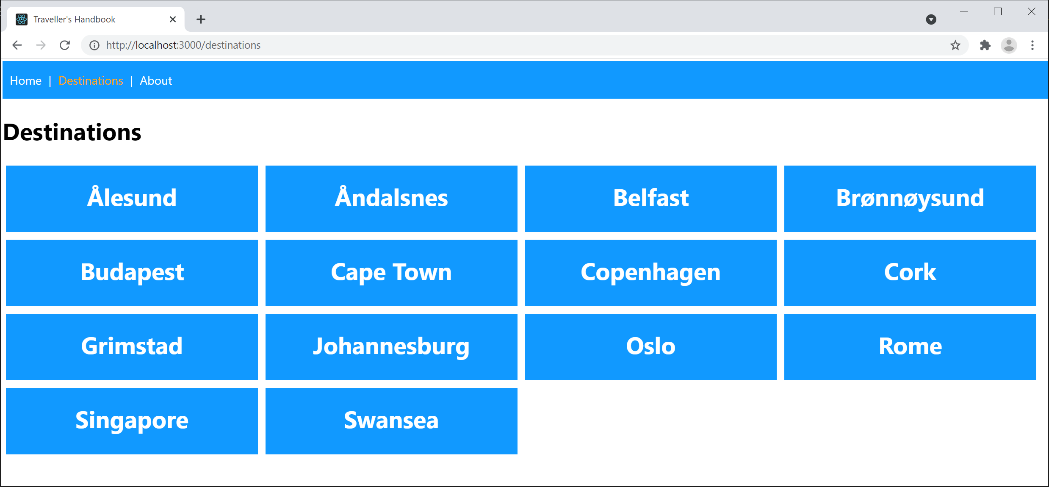
Viewing the Destinations Component
In the client app, browse to the /destinations location
The Destinations component is activated

Slide 16
How the Destinations Component Works
The Destinations component gets its destinations data via a REST call to the server
This is asynchronous, so it could take a while…
When the destinations data arrives back:
We store the destinations data in React state, which causes React to re-render the component

Slide 17
Using React State Storage
You can't store state (data) in a local variable
Local variables disappear at the end of the function
Instead, you must use React.useState():
React.useState() returns:
A reference to state data maintained by React
A function to call if you change the state to tell React to re-render your component
let [destinations, setDestinations] = React.useState<Array<any>>([])
let [destinations, setDestinations] = React.useState<Array<any>>([])
let [destinations, setDestinations] = React.useState<Array<any>>([])
Destinations.tsx
Destinations.tsx
Destinations.tsx

Slide 18
Using React Effect Hooks
You don't need to get data on every render
Just get data after the first render, and store it in React state
If you have work you want to do after a component is rendered, call React.useEffect()
Note the parameters to useEffect():
A lambda, specifying the work to do
An empty dependency array
React.useEffect(() => {
RestClient.getDestinations()
.then(destinations => setDestinations(destinations))
}, [])
React.useEffect(() => {
RestClient.getDestinations()
.then(destinations => setDestinations(destinations))
}, [])
React.useEffect(() => {
RestClient.getDestinations()
.then(destinations => setDestinations(destinations))
}, [])
Destinations.tsx
Destinations.tsx
Destinations.tsx

Slide 19
Displaying Parameterized Route Links
The Destinations component displays hyperlinks for all the destinations, parameterized by id
E.g., destination/1
index.css defines styles so the links look nice ☺
{destinations.map((dest: any, i: number) =>
<Link to={`destination/${dest.id}`} key={i} className='blockLink'>{dest.place}</Link>
)}
Destinations.tsx
.blockLink { … … … }
.blockLink:hover { … … … }
index.css

Slide 20
Lesson 11: Implementing a Compelling UI in React
11.4 Displaying One Destination

Slide 21
Overview
We're going to see how to display one destination in our React client application
Here's a reminder of how to run the server application:
In IntelliJ, open demo-full-stack-app
Run the Application class
Here's a reminder of how to run the React client application:
Open a Command Prompt window in demo-full-stack-client
Run
Run
npm install
npm start

Slide 22
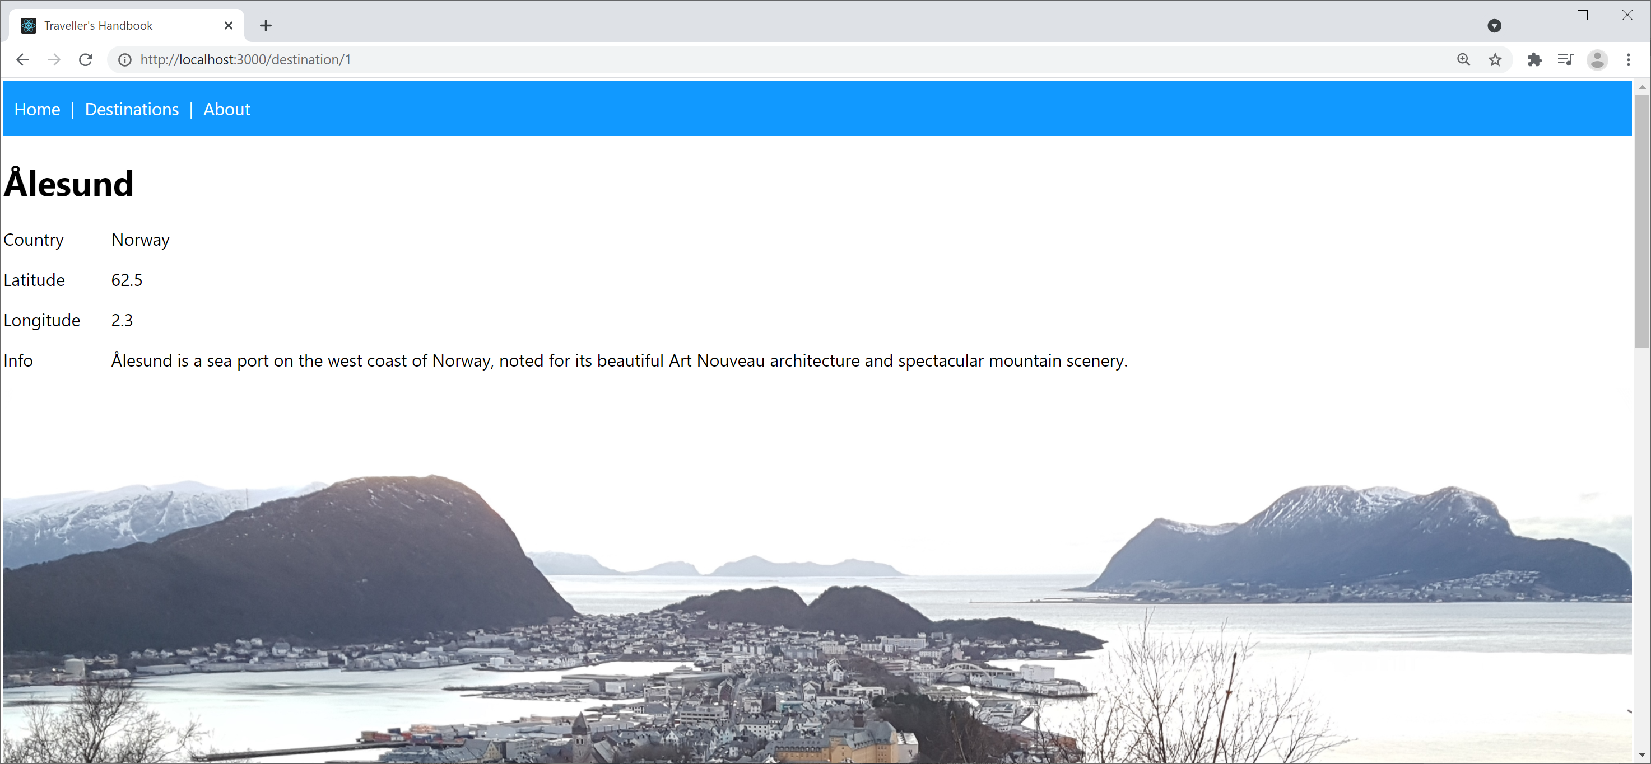
Viewing the Destination Component
Click one of the destination links
The Destination component is activated, with an id
The component displays details for that destination

Slide 23
How the Destination Component Works
The Destination component gets the id parameter from the location URL (see the routing table)
The component then gets data for that destination, and stores the data in React state
let {id} : any = useParams()
Destination.tsx
let [destination, setDestination] = React.useState<any>(undefined)
React.useEffect(() => {
RestClient.getDestination(id)
.then(destination => setDestination(destination))
.catch(err => alert(err))
}, [id])
Destination.tsx

Slide 24
Component Modular Decomposition
The Destination component is quite complex
So we render it in 2 separate sub-components
<DestinationDetails> is quite straightforward
It just displays destination details
<DestinationReviews> is more tricky
See next sub-lesson!
<React.Fragment>
<DestinationDetails {...destination} />
<DestinationReviews {...destination} />
</React.Fragment>
Destination.tsx

Slide 25
Lesson 11: Implementing a Compelling UI in React
11.5 Displaying and Adding Reviews for a Destination

Slide 26
Overview
We're going to see how to display and add reviews for a destination in our React client application
Here's a reminder of how to run the server application:
In IntelliJ, open demo-full-stack-app
Run the Application class
Here's a reminder of how to run the React client application:
Open a Command Prompt window in demo-full-stack-client
Run
Run
npm install
npm start

Slide 27
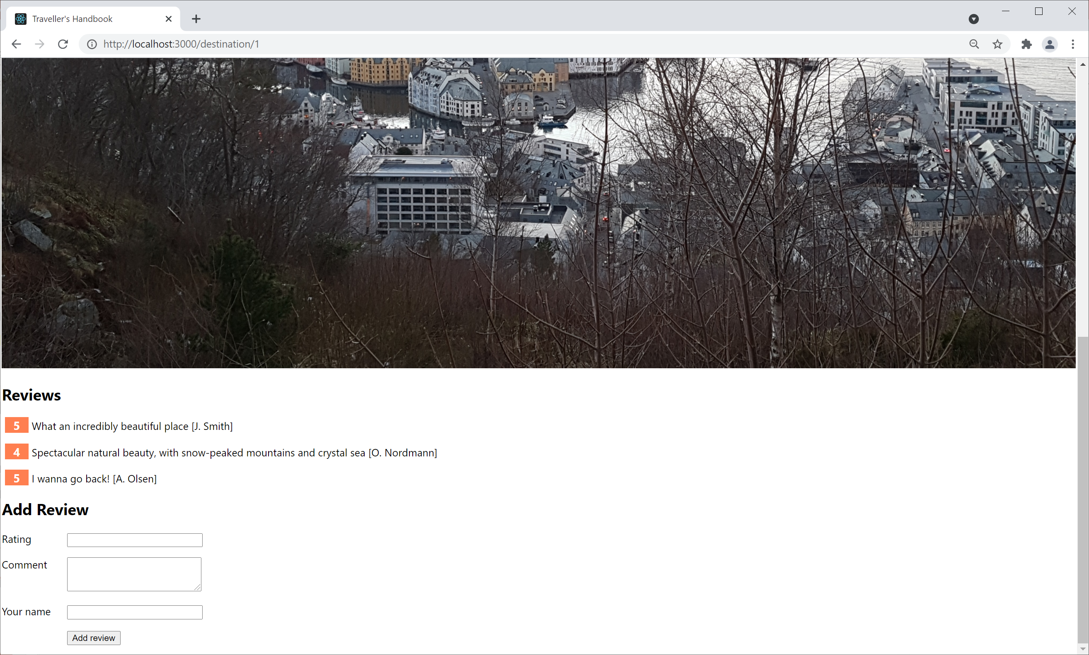
Viewing Reviews for a Destination Component
Click through to display a destination, and then scroll down to display reviews for that destination:
Rendered by the DestinationReviews
component

Slide 28
Defining and Using Custom Hooks
The DestinationReviews component makes use of "custom hooks" to simplify the logic:
A custom hook is a helper function
Reusable logic to simplify components
Name conventionally starts with use
Can use React state, React effects, etc.
function DestinationReviews(destination: any) {
return (
<React.Fragment>
{useReviewsMarkup(destination)}
{useAddReviewFormMarkup(destination)}
</React.Fragment>
)
}
Custom hook
Custom hook
Destination.tsx

Slide 29
Defining the useReviewsMarkup Hook
Here's the useReviewsMarkup custom hook:
A custom hook can have any signature you like
Whatever arguments are appropriate
Whatever return type is appropriate
function useReviewsMarkup(destination: any) {
if (!destination.reviews || !destination.reviews.length) {
return <div>No reviews yet</div>
}
else {
return (
<div>
<h2>Reviews</h2>
{destination.reviews.map((r: any, i: number) => … … … )}
</div>
)
}
}

Slide 30
Defining the useAddReviewFormMarkup Hook
The addReviewFormMarkup() custom hook displays a <form> where the user can add a review
When the user submits the form, the function:
Collates the review details into an object
Sends the review object to the server via a REST API
Adds the review to the client-side destination object
Causes the component to re-render (via a state change)
Let's see the details…

Slide 31
That's All Folks!
We've reached the end of the course!
Here's a reminder of what we've created:
Web
UI
Web
server
app
REST
service
Persistence
HTML
CSS
TypeScript
React
Java 11
Spring Boot
H2 RDBMS

